Slide 1
Midterm 2 Review
CS436/536: Introduction to
Machine Learning
Zhaohan Xi
Binghamton University
^{zxi1@binghamton.edu}

Slide 2
Neural Networks

Slide 3
Reminder: The Perceptron Model
$$h=sign(w^{T}x)=sign\left(w_{0}+w_{1}x_{1}+w_{2}x_{2}\right)$$
$$1$$
$$w_{0}$$
$$w_{1}$$
$$x_{1}$$
$$sign\left(w^{T}x\right)$$
$$w_{2}$$
$$x_{2}$$

Slide 4
The Neural Network
$$1$$
$$1$$
$$1$$
$$x_{1}$$
$$θ$$
$$θ$$
$$θ$$
$$h(x)$$
$$x_{2}$$
$$θ$$
$$θ$$
$i$-th node
$$⋮$$
$$θ$$
$$d^{(l)}$$
dimension of layer $l$
$$x_{d}$$
Input layer
$$l=0$$
Hidden layers
$$0<l<L$$
Output layer
$$l=L$$

Slide 5
Anatomy and Physiology of a Hidden Node
$$W^{(l)}$$
$$W^{(l+1)}$$
$$θ$$
$$s_{i}^{(l)}$$
$$x_{i}^{(l)}$$
+
$$θ$$
$$W_{hi}^{\left(l\right)}$$
$h$-th node
$i$-th node
layer
$$l−1$$
layer
$$l$$
layer
$$l+1$$
1
$x^{(l)}$ | $d^{(l)}+1$ dimensional output vector

Slide 6
Anatomy and Physiology of a Hidden Node
$$W^{(l)}$$
$$W^{(l+1)}$$
$$θ$$
$$s_{i}^{(l)}$$
$$x_{i}^{(l)}$$
+
$$θ$$
$$W_{hi}^{\left(l\right)}$$
$h$-th node
$i$-th node
layer
$$l−1$$
layer
$$l$$
layer
$$l+1$$
signals in | $s^{(l)}$ | $d^{(l)}$ dimensional input vector
outputs | $x^{(l)}$ | $d^{(l)}+1$ dimensional output vector
1
weights in | $W^{(l)}$ | $\left(d^{\left(l−1\right)}+1\right)×d^{(l)}$ dimensional matrix

Slide 7
Anatomy and Physiology of a Hidden Node
$$W^{(l)}$$
$$W^{(l+1)}$$
layer $l$
has “dimension” $d^{(l)}$
i.e. $d^{(l)}+1$ nodes
$$W^{(l)}=\left[\begin{aligned}w_{1}^{(l)}w_{2}^{(l)}…w_{d^{(l)}}^{(l)} \\ \\ \end{aligned}\right]$$
$$θ$$
$$s_{i}^{(l)}$$
$$x_{i}^{(l)}$$
+
$$θ$$
$$W_{hi}^{\left(l\right)}$$
$h$-th node
$i$-th node
layer
$$l−1$$
layer
$$l$$
layer
$$l+1$$
signals in | $s^{(l)}$ | $d^{(l)}$ dimensional input vector
outputs | $x^{(l)}$ | $d^{(l)}+1$ dimensional output vector
weights in | $W^{(l)}$ | $\left(d^{\left(l−1\right)}+1\right)×d^{(l)}$ dimensional matrix
weights out | $W^{(l+1)}$ | $\left(d^{\left(l\right)}+1\right)×d^{(l+1)}$ dimensional matrix

Slide 8
Anatomy and Physiology of a Layer
Input
Signal
+
node $i$
$$x^{(l−1)}$$
$$W^{(l)}$$
$$s^{(l)}$$
$$θ$$
$$x^{(l)}$$
$$⋯$$
$$h(x)$$
layer $l$

Slide 9
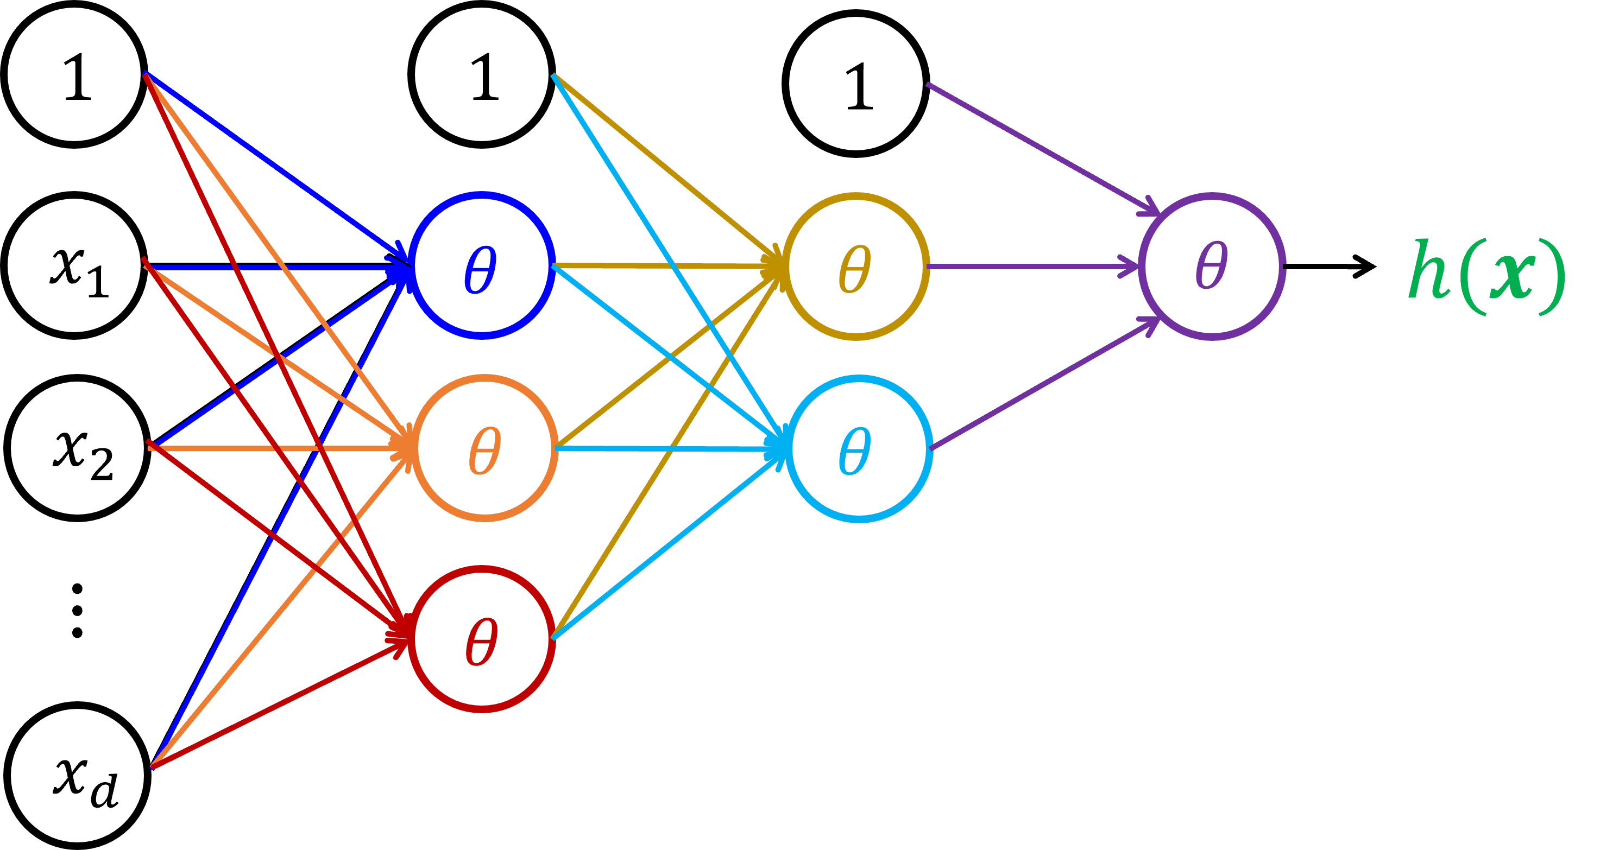
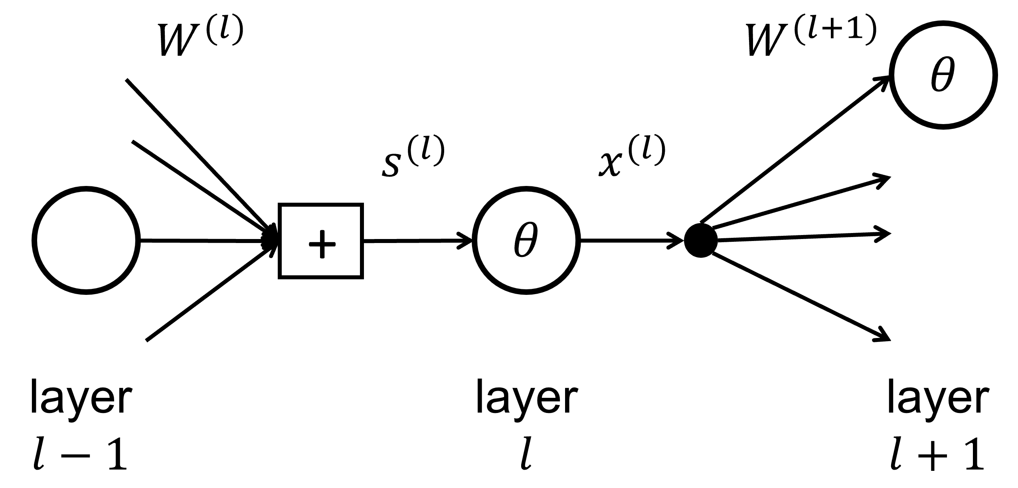
The Linear Signal $s^{(l)}$ into layer $l$
$$s^{(l)}={\left(W^{\left(l\right)}\right)}^{T}x^{(l−1)}$$
at layer $l$
$s^{(l)}$ is a linear combination (using $W^{(l)}$)
of the outputs of the previous layer $x^{(l−1)}$
$\left[\begin{aligned}s_{1}^{(l)} \\ s_{2}^{(l)} \\ ⋮ \\ s_{i}^{(l)} \\ ⋮ \\ s_{d^{(l)}}^{(l)}\end{aligned}\right]=\left[\begin{aligned}{\left(w_{1}^{\left(l\right)}\right)}^{T}− \\ {\left(w_{2}^{\left(l\right)}\right)}^{T}− \\ ⋮ \\ {\left(w_{i}^{\left(l\right)}\right)}^{T}− \\ ⋮ \\ {\left(w_{d^{(l)}}^{\left(l\right)}\right)}^{T}−\end{aligned}\right]x^{(l−1)}$
from
$$s_{i}^{(l)}={\left(w_{i}^{\left(l\right)}\right)}^{T}x^{(l−1)}$$
at each node $i$ in layer $l$

Slide 10
The Output $x^{(l)}$ out of layer $l$
$$x^{(l)}=θ\left(s^{\left(l\right)}\right)$$
at layer $l$
$s^{(l)}$ is a linear combination (using $W^{(l)}$)
of the outputs of the previous layer $x^{(l−1)}$
$\left[\begin{aligned}x_{1}^{(l)} \\ x_{2}^{(l)} \\ ⋮ \\ x_{i}^{(l)} \\ ⋮ \\ x_{d^{(l)}}^{(l)}\end{aligned}\right]=θ\left(\left[\begin{aligned}s_{1}^{(l)} \\ s_{2}^{(l)} \\ ⋮ \\ s_{i}^{(l)} \\ ⋮ \\ s_{d^{(l)}}^{(l)}\end{aligned}\right]\right)$
from
$$x_{i}^{(l)}=θ\left(s_{i}^{\left(l\right)}\right)$$
at each node $i$ in layer $l$

Slide 11
Forward Propagation: Computing $h(x)$
$$W^{(1)}$$
$$θ$$
$$W^{(2)}$$
$$θ$$
$$W^{(L)}$$
$$θ$$
$$x=x^{(0)} →s^{(1)}→x^{(1)} →s^{(2)}→ x^{(2)} →…→s^{\left(L\right)}→x^{\left(L\right)}=h(x)$$
$x^{(0)}←x$ [Initialization]
for $l=1…L$ do [Forward Propagation]
$s^{(l)}←{\left(W^{(l)}\right)}^{T}x^{(l−1)}$
$x^{(l)}←\left[\begin{aligned}1 \\ θ(s^{(l)})\end{aligned}\right]$
end for
$h\left(x\right)=x^{(L)}$ [Output]

Slide 12
The Neural Network
Defined by:
$$W=\{W^{\left(1\right)},W^{\left(2\right)},…,W^{\left(L\right)}\}$$
$$W^{(l)}$$
$$W^{(l+1)}$$
$$W^{(L)}$$
$$1$$
$$1$$
$$1$$
$$x_{1}$$
$$θ$$
$$θ$$
$$θ$$
$$h(x)$$
$$x_{2}$$
$$θ$$
$$θ$$
$$d^{(l+1)}$$
$$⋮$$
$$θ$$
$$d^{(l)}$$
How many nodes in the neural network?
How many weights do we have to learn?
How many computations of $θ$?
How many multiplications to compute $E_{in}\left(W\right)$
$$x_{d}$$

Slide 13
Backpropagation To Compute Sensitivities $$δ^{(1)}←…←δ^{(L−2)}←δ^{(L−1)}←δ^{(L)}$$
1. Forward Propagation to compute $x^{(l)}$, $s^{(l)}$ for $l=1,…,L$
2. Set $δ^{(L)}←2(x^{\left(L\right)}−y)θ′(s^{(L)})$
$θ^{′}\left(s^{\left(L\right)}\right)=1−{\left(x^{(L)}\right)}^{2}$
3. For $l=L−1, …, 1$ do
4. Compute for each $\tanh{(⋅)}$ hidden node:
$$θ^{′}\left(s^{\left(l\right)}\right)={\left[1−x^{\left(l\right)}⊙x^{\left(l\right)}\right]}_{1}^{d^{(l)}}$$
5. Compute sensitivity $δ^{(l)}$ from $δ^{(l+1)}$
$δ^{(l)}←θ^{′}\left(s^{\left(l\right)}\right)⊙{\left[W^{\left(l+1\right)}δ^{(l+1)}\right]}_{1}^{d^{(l)}}$
6. End For

Slide 14
Neural Networks Overfit

Slide 15
Regularization

Slide 16
Regularization – Weight Decay
$$E_{aug}\left(w\right)=E_{in}\left(w\right)+\frac{λ}{N}{\sum_{l,i,j}{\left(w_{ij}^{\left(l\right)}\right)}}^{2}$$
$$\frac{∂E_{aug}(w)}{∂W^{(l)}}=\frac{∂E_{in}(w)}{∂W^{(l)}}+\frac{2λ}{N}W^{(l)}$$

Slide 17
Early Stopping
Use a validation step to decide when to stop
When reducing $E_{in}$ does not reduce $E_{val}$

Slide 18
Variable Learning Rate
Set $α>1$, $β<1$,
Compute gradient $g\left(t\right)$ at weights $w\left(t\right)$
If $E_{in}\left(w\left(t\right)−ηg(t)\right)<E_{in}(w(t))$ do
accept: $w\left(t+1\right)=w\left(t\right)−ηg(t)$
$η=αη$, increase the learning rate
Else:
reject: $w\left(t+1\right)=w\left(t\right)$
$η=βη$, decrease learning rate

Slide 19
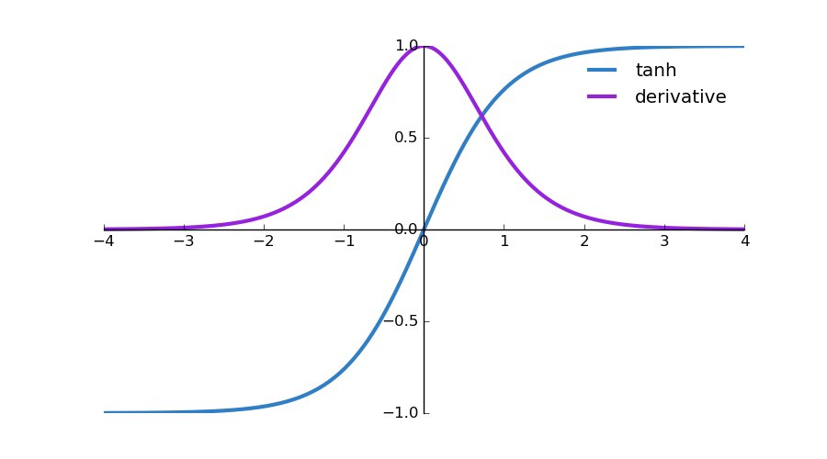
A Problem: The Vanishing Gradient
$δ^{(l)}←θ^{′}\left(s^{\left(l\right)}\right)⊙{\left[W^{\left(l+1\right)}δ^{(l+1)}\right]}_{1}^{d^{(l)}}$
$δ^{(l)}←θ^{′}\left(s^{\left(l\right)}\right)⊙{\left[W^{\left(l+1\right)}\left[θ^{′}\left(s^{\left(l+1\right)}\right)⊙{\left[W^{\left(l+2\right)}δ^{\left(l+2\right)}\right]}_{1}^{d^{\left(l+1\right)}}\right]\right]}_{1}^{d^{(l)}}$
$δ^{(l)}←θ^{′}\left(s^{\left(l\right)}\right)⊙{\left[W^{\left(l+1\right)}\left[θ^{′}\left(s^{\left(l+1\right)}\right)⊙{\left[W^{\left(l+2\right)}[θ^{′}\left(s^{\left(l+2\right)}\right)⊙{\left[W^{\left(l+3\right)}δ^{(l+3)}\right]}_{1}^{d^{(l+2)}}]\right]}_{1}^{d^{\left(l+1\right)}}\right]\right]}_{1}^{d^{(l)}}$
$$\left|θ^{′}\left(s^{\left(l\right)}\right)\right|<1$$
As $L$ increases, product $→0$

Slide 20
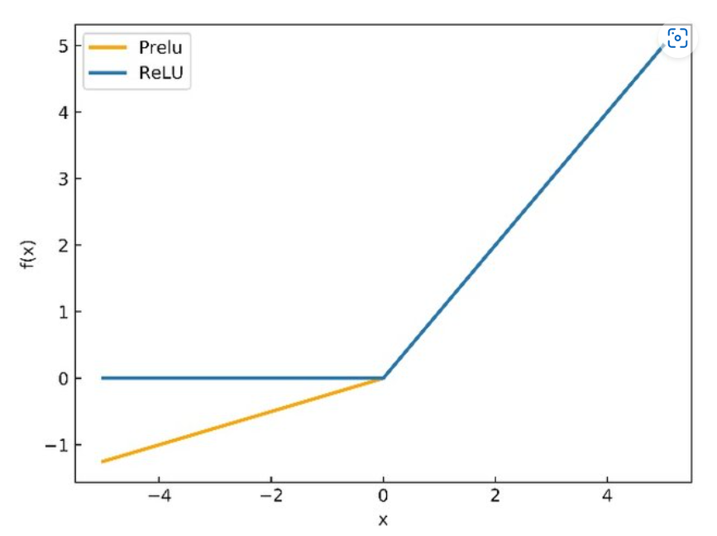
A Solution: The ReLU
Rectified Linear Unit (ReLU)
$relu\left(s\right)=\max\left\{0,s\right\}$
derivative:
$\frac{d}{ds}relu\left(s\right)=\left\{\begin{aligned}1,if s≥0 \\ 0, otherwise\end{aligned} \right.$
Also promote sparsity (few nonzero weights)
Parameterized ReLU (PReLU)
$prelu\left(x\right)=\left\{\begin{aligned}s,if s≥0 \\ as, if s<0\end{aligned}\right.$, where $a$ is a learnable parameter

Slide 21
A Similar Problem: Exploding Gradient
Multiplying many large values for the partial derivatives
Causes large gradients
Causes numerical instability
Some solutions:
Redesign the neural network
Reinitialize the weights
Gradient clipping $\left\|G\right\|≤c$ (scale down the gradients so norm is under budget)
Use weight decay regularization

Slide 22
Dropout Regularization
During Training only
Randomly set the output of a few nodes to 0
Artificially pretends as if there are fewer nodes
Make noisier predictions
Can specify dropout rate
at each layer
$$W^{(l)}$$
$$W^{(l+1)}$$
$$θ$$
$$s_{i}^{(l)}$$
$$x_{i}^{(l)}$$
+
$$θ$$
$$W_{ji}^{\left(l\right)}$$
Example implementation:
$$x_{i}^{(l)}=θ\left(ρ_{i}^{\left(l\right)}s_{i}^{(l)}\right)$$
where $ρ_{i}^{(l)}$ is a Bernoulli random variable
$i$-th node
layer
$$l−1$$
layer
$$l$$
layer
$$l+1$$

Slide 23
Breaking the symmetry during initialization
Symmetry (e.g. by setting the same weight for all edges) can cause:
Backpropagation only scales all weights equally
Cannot train the neural network
Random initialization (Uniform distribution)
Xavier initialization (Uniform distribution from network statistics)
Never set to constant across each layer
Never set to extreme large values
Another solution: Dropout (covered later)

Slide 24
Naïve Bayes

Slide 25
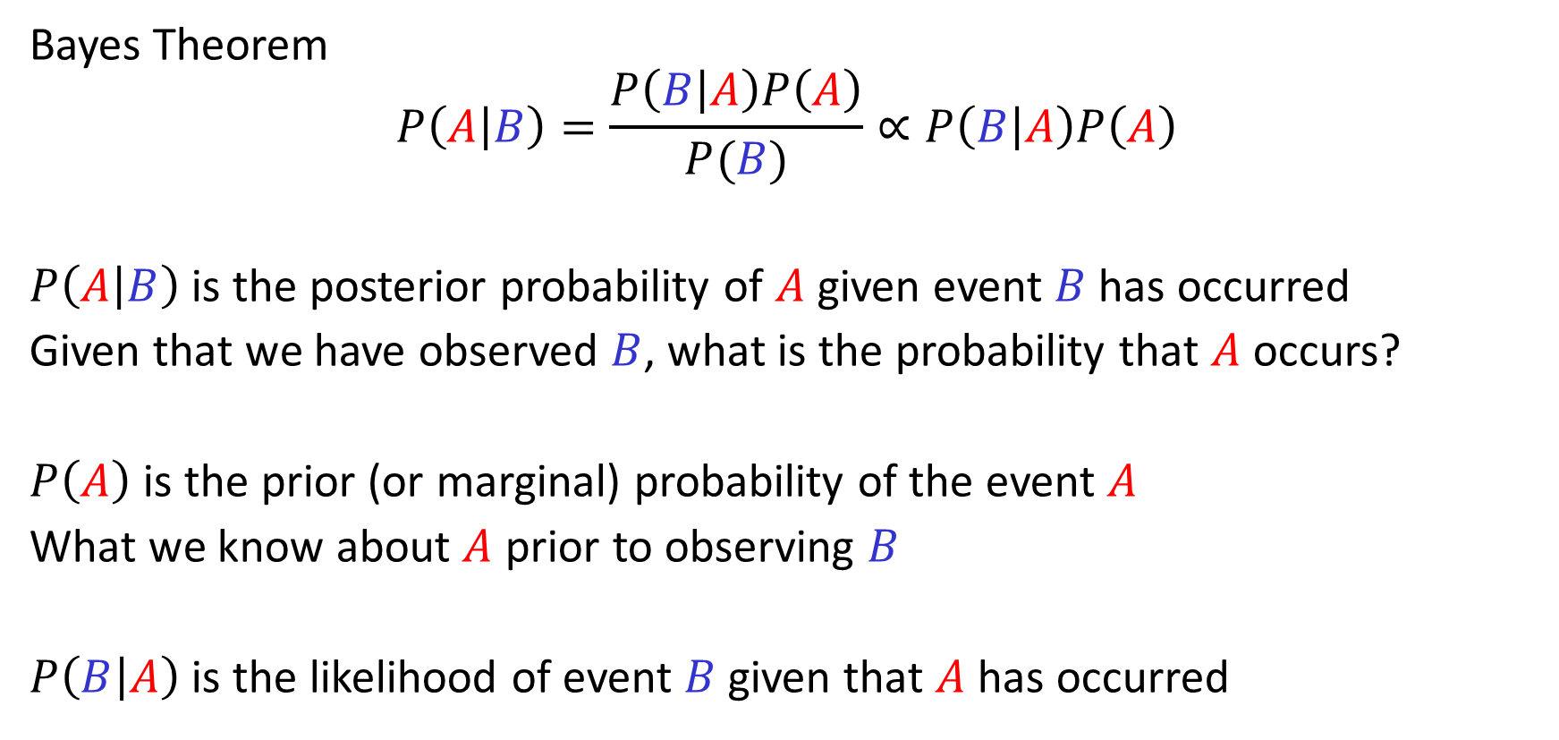
Probability Primer: Bayes’ Theorem
Bayes Theorem
$$P\left(A | B\right)=\frac{P\left(B | A\right)P\left(A\right)}{P(B)}∝P\left(B | A\right)P\left(A\right)$$
$P\left(A | B\right)$is the posterior probability of $A$ given event $B$ has occurred
Given that we have observed $B$, what is the probability that $A$ occurs?
$P\left(A\right)$is the prior (or marginal) probability of the event $A$
What we know about $A$ prior to observing $B$
$P\left(B | A\right)$ is the likelihood of event $B$ given that $A$ has occurred

Slide 26
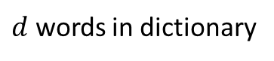
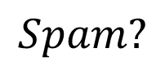

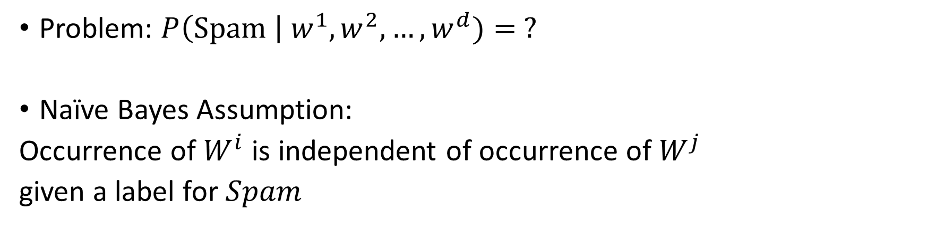
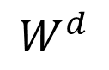
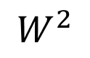
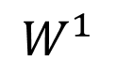
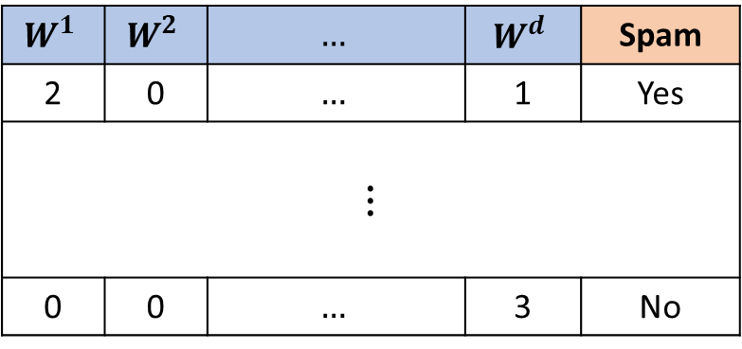
Example: Text Classification
$$W^{1}$$ | $$W^{2}$$ | $$…$$ | $$W^{d}$$ | Spam
2 | 0 | $$…$$ | 1 | Yes
$$⋮$$
0 | 0 | $$…$$ | 3 | No
Infer whether
document is spam
$$Spam?$$
Given observed
word frequencies
$$W^{1}$$
$$W^{2}$$
$$⋯$$
$$W^{d}$$
$d$ words in dictionary
Problem: $P\left(Spam \right| w^{1},w^{2},…,w^{d})= ?$
Naïve Bayes Assumption:
Occurrence of $W^{i}$ is independent of occurrence of $W^{j}$
given a label for $Spam$

Slide 27
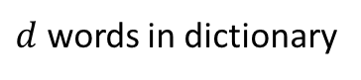
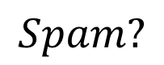

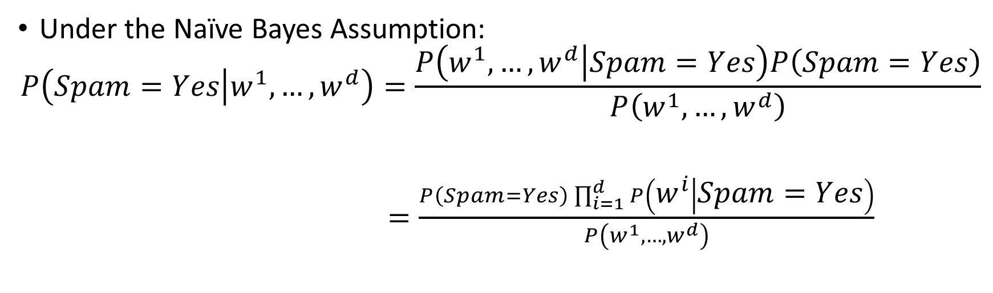
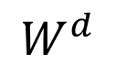
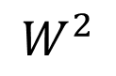
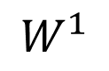
Example: Text Classification
Infer whether
document is spam
$$Spam?$$
Given observed
word frequencies
$$W^{1}$$
$$W^{2}$$
$$⋯$$
$$W^{d}$$
$d$ words in dictionary
Under the Naïve Bayes Assumption:
$$P\left(Spam=Yes | w^{1},…,w^{d}\right)=\frac{P\left(w^{1},…,w^{d} | Spam=Yes\right)P\left(Spam=Yes\right)}{P\left(w^{1},…,w^{d}\right)}$$
$=\frac{P\left(Spam=Yes\right)\prod_{i=1}^{d}{P\left(w^{i} | Spam=Yes\right)}}{P\left(w^{1},…,w^{d}\right)}$

Slide 28
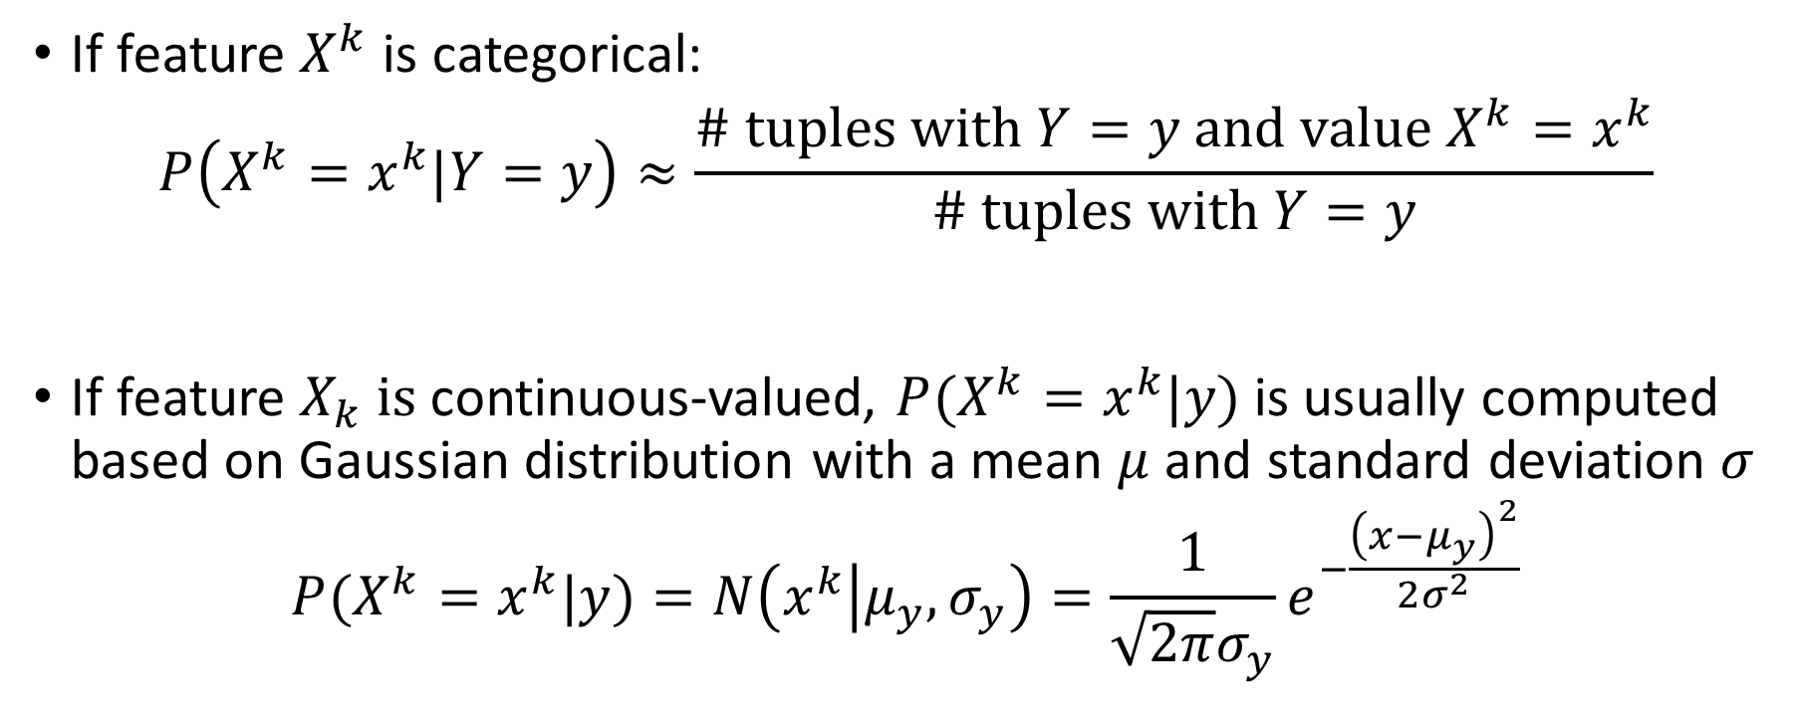
Naïve Bayes: Categorical vs. Continuous Features
If feature $X^{k}$ is categorical:
$$P\left(X^{k}=x^{k}|Y=y\right)≈\frac{\# tuples with Y=y and value {X^{k}=x}^{k}}{\# tuples with Y=y}$$
If feature $X_{k} is$continuous-valued, $P(X^{k}=x^{k}|y)$ is usually computed based on Gaussian distribution with a mean $μ$ and standard deviation $σ$
$$P(X^{k}=x^{k}|y)=N\left(x^{k} | μ_{y}, σ_{y}\right)=\frac{1}{\sqrt{2π}σ_{y}}e^{−\frac{{\left(x−μ_{y}\right)}^{2}}{2σ^{2}}}$$

Slide 29

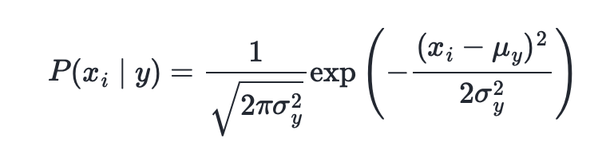
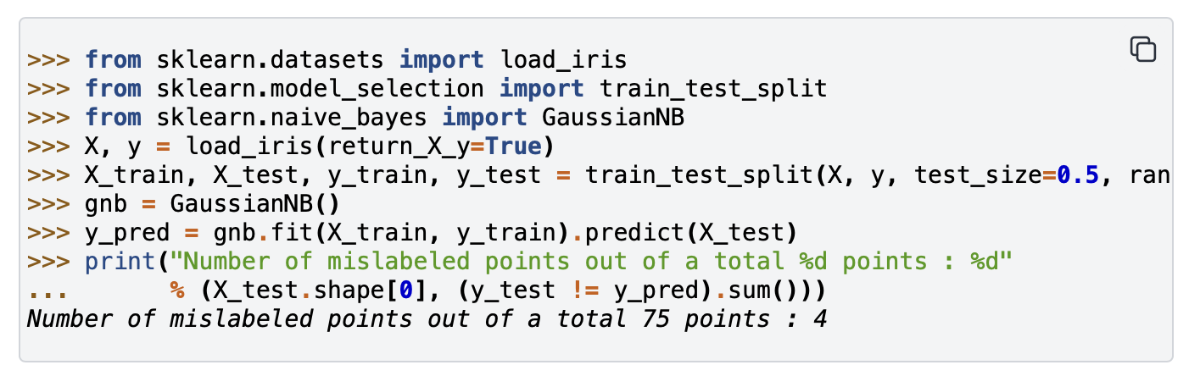
The likelihood of the features is assumed to be Gaussian:

Slide 30
Decision Tree

Slide 31
Lectures 17-18
CS436/536: Introduction to
Machine Learning
Zhaohan Xi
Binghamton University
^{zxi1@binghamton.edu}

Slide 32
Basic Decision Trees Learning Algorithm
 | O | T | H | W | Play?
1 | S | H | H | W | -
2 | S | H | H | S | -
3 | O | H | H | W | +
4 | R | M | H | W | +
5 | R | C | N | W | +
6 | R | C | N | S | -
7 | O | C | N | S | +
8 | S | M | H | W | -
9 | S | C | N | W | +
10 | R | M | N | W | +
11 | S | M | N | S | +
12 | O | M | H | S | +
13 | O | H | N | W | +
14 | R | M | H | S | -
Data is processed in Batch (i.e. all the data available)
Recursively build a decision tree top down.
Algorithm?
Outlook
Sunny
Overcast
Rain
Humidity
Yes
Wind
High
Normal
Strong
Weak
No
Yes
No
Yes

Slide 33
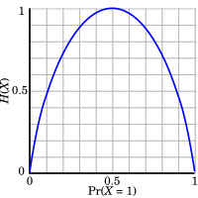
Entropy
Entropy (impurity, disorder) of a set of examples, S, relative to a binary classification is:
$$Entropy\left(S\right)=−p_{+ }\log\left(p_{+}\right)−p_{− }\log\left(p_{−}\right)$$
$p_{+ }$is the proportion of positive examples in S and
$p_{− }$is the proportion of negatives examples in S
If all the examples belong to the same category: Entropy = 0
If all the examples are equally mixed (0.5, 0.5): Entropy = 1
Entropy = Level of uncertainty.
$$Entropy\left(S\right)=−p_{+ }\log\left(p_{+}\right)−(1−p_{+ })\log\left(1−p_{+ }\right)$$

Slide 34
Entropy
Entropy (impurity, disorder) of a set of examples, S, relative to a binary classification is:
$$Entropy\left(S\right)=−p_{+ }\log\left(p_{+}\right)−p_{− }\log\left(p_{−}\right)$$
$p_{+ }$is the proportion of positive examples in S and
$p_{− }$is the proportion of negatives examples in S
If all the examples belong to the same category: Entropy = 0
If all the examples are equally mixed (0.5, 0.5): Entropy = 1
Entropy = Level of uncertainty.
In general, when p_{i} is the fraction of examples labeled i:
$$Entropy\left(S\left[p1,p2 ,…,pk\right]\right)=−\sum_{1}^{k}{p_{i}}\log\left(p_{i}\right)$$

Slide 35
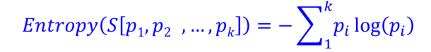
Entropy
(Convince yourself that the max value would be $\log\left(k\right)$ )
(Also note that the base of the log only introduce a constant factor; therefore, we’ll think about base 2)
1
1
1

Slide 36
Information Gain
High Entropy – High level of Uncertainty
Low Entropy – No Uncertainty.
The information gain of an attribute a is the expected reduction in entropy caused by partitioning on this attribute
$$Gain\left(S,a\right)=Entropy\left(S\right) −\sum_{v∈values(S)}{\frac{|S_{v}|}{|S|} Entropy(S_{v})}$$
Where:
S_{v} is the subset of S for which attribute a has value v, and
the entropy of partitioning the data is calculated by weighing the entropy of each partition by its size relative to the original set
Partitions of low entropy (imbalanced splits) lead to high gain
Go back to check which of the A, B splits is better
Outlook
Sunny
Overcast
Rain
Notes:
The A, B case:
If we choose A: the reduction is: 100/203 Ent(100,0) + 103/203 Ent(100,3) ~~ 0
If we choose B: the reduction is: 53/203 Ent(53,0) + 150/203 Ent(100,50) >> 0

Slide 37
Pros and Cons
Pros
Easy to explain (even for non-expert)
Easy to implement (many software)
Efficient
Can tolerant missing data
White box
No need to normalize data
Non-parametric: No assumption on data distribution, no assumption on attribute independency
Can work on various attribute types

Slide 38
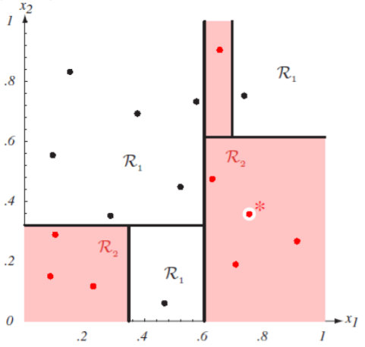
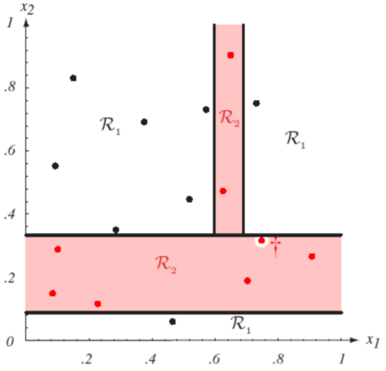
Cons
Con’s
Unstable. Sensitive to noise
Accuracy may be not good enough (depending on your data)
The optimal splitting is NP. Greedy algorithms are used
Overfitting
Notes:
http://cse.msu.edu/~cse802/DecisionTrees.pdf

Slide 39
Reasons for overfitting
Too much variance in the training data
Training data is not a representative sample of the instance space
We split on features that are actually irrelevant
Too much noise in the training data
Noise = some feature values or class labels are incorrect
We learn to predict the noise
In both cases, it is a result of our will to minimize the empirical error when we learn, and the ability to do it (with DTs)

Slide 40
Pruning a decision tree
Prune = remove leaves and assign majority label of the parent to all items
Prune the children of node s if:
all children are leaves, and
the accuracy on the validation set does not decrease if we assign the most frequent class label to all items at s.

Slide 41
Techniques to Improve Classification Accuracy
Introducing Ensemble Methods
Bagging
Boosting
Random Forests
Imbalanced Classification
Notes:
41

Slide 42
Ensemble Methods: Increasing the Accuracy
Popular ensemble methods
Bagging: Picks different hypotheses, each using a possibly different subset of the training set
Can be learned in parallel
Boosting: Picks each new hypothesis sequentially to emphasize the training instances that previous hypotheses mis-classified
Bagging
Boosting

Slide 43
Bagging: Bootstrap Aggregation
Training
For $i = 1, …, k$
create bootstrap sample $Di$ by sampling from $D$ with replacement;
use $Di$ and the learning algorithm to pick hypothesis $g_{i}$ ;
Classification: classify an unknown sample $x$
let each of the $k$ models classify $x$ and return the majority vote
Prediction:
To predict continuous variables, use average prediction instead of vote

Slide 44
Boosting
How boosting works?
$K$ classifiers are learned iteratively
After classifier $g_{i}$ is learned,
set the subsequent classifier, $g_{i+1}$,
to pay more attention to the training tuples that were misclassified by $g_{i}$
The final $g^{∗}$ combines the votes of each individual classifier, where the weight of each classifier's vote is a function of its accuracy
Boosting algorithm can be extended for numeric prediction

Slide 45
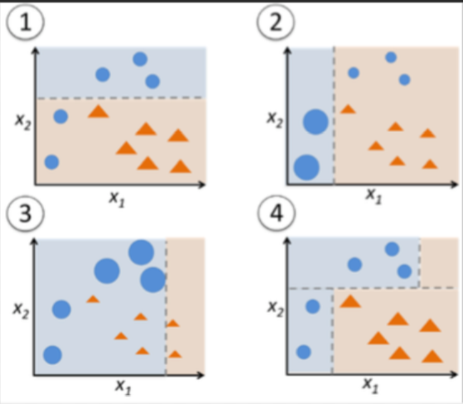
Adaboost (Freund and Schapire, 1997)
3. Update weights based on current model
1. Assign initial weights to each training tuple
$\left\{w_{n}^{\left(1\right)}\right\}$
$$\left\{w_{n}^{\left(2\right)}\right\}$$
$$\left\{w_{n}^{\left(K\right)}\right\}$$
…
2. Train base classifier on weighted dataset
$$g_{1}$$
$$g_{2}$$
…
$$g_{K}$$
4. After base classifiers are trained, they are combined to give the final classifier
Two ‘weighting’ strategy:
Assign weights to each training example
Sample dataset based on weight distribution
$$g^{∗}\left(x\right)=sign\left(\sum_{i=1}^{K}{α_{i}g_{i}\left(x\right)}\right)$$

Slide 46
Random Forest: Basic Concepts
Random Forest (first proposed by L. Breiman in 2001)
Bagging with decision trees as base hypotheses
Data bagging
Use a subset of training data by sampling with replacement for each tree
Feature bagging
At each node use a random selection of attributes as candidates and split by the best attribute among them
During classification, each tree votes and the most popular class is returned
Advantage of decision trees – more diversity

Slide 47
Random Forest
Two Methods:
Forest-RI (random input selection):
At each node, randomly select F attributes as candidates for the split at the node.
Forest-RC (random linear combinations):
Creates new features that are a linear combination of the existing attributes (reduces the correlation between individual classifiers)
Comparable in accuracy to Adaboost, but more robust to errors and outliers
Insensitive to the number of attributes selected for consideration at each split, and faster than typical bagging or boosting

Slide 48
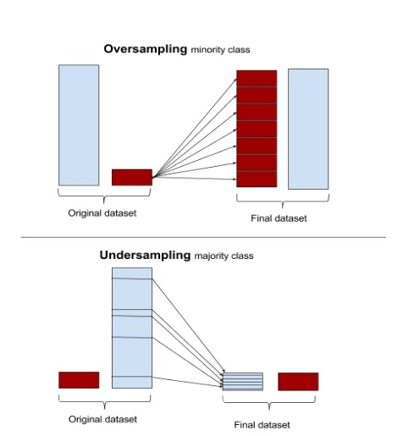
Classification of Class-Imbalanced Data Sets
Typical methods on imbalanced data (Balance the training set)
Oversampling: Oversample the minority class.
Under-sampling: Randomly eliminate tuples from majority class
Synthesizing: Synthesize new minority classes

Slide 49
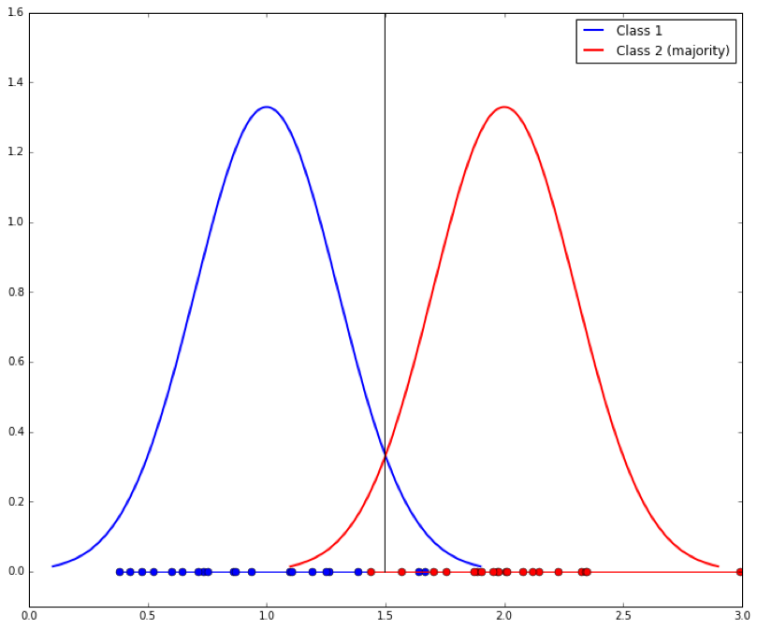
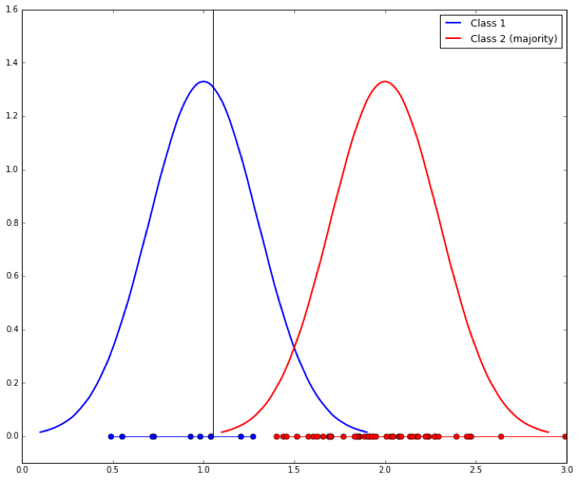
Classification of Class-Imbalanced Data Sets
Typical methods on imbalanced data (At the algorithm level)
Threshold-moving: Move the decision threshold $t$ so that the rare class tuples are easier to classify, and hence, less chance of costly false negative errors
Class weight adjusting: When false negative costs more than false positive, we can give larger weight to false negative
Ensemble techniques: Ensemble of multiple classifiers
Threshold-moving

Slide 50
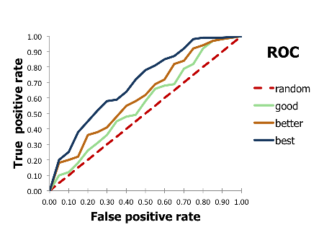
Evaluate imbalanced data classifier
Accuracy alone can be misleading
Accuracy simply counts the number of errors.
If a data set has 2% positive labels and 98% negative labels,
a classifier that maps all inputs to negative class will get an accuracy of 98%!
ROC Curve

Slide 51
SVM

Slide 52
Robustness: The Cushion Around the Separator
Fat cushion
thickness =
distance to closest data point
margin
The amount of noise the separator can tolerate

Slide 53
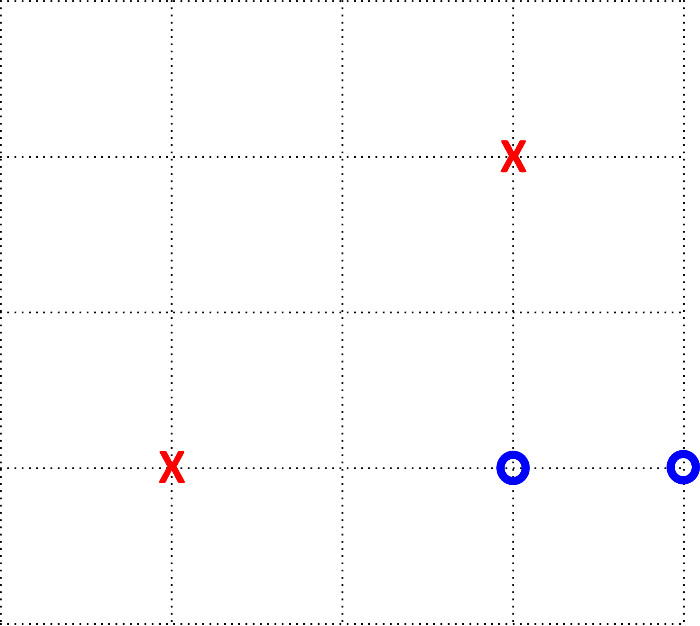
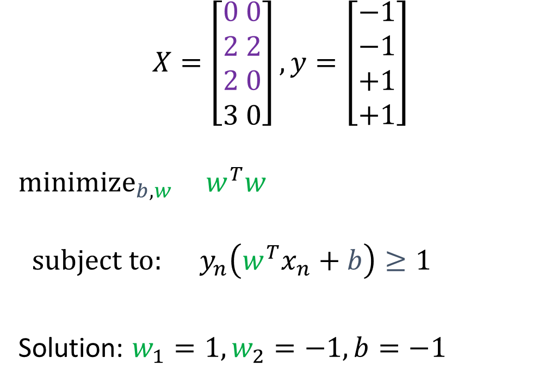
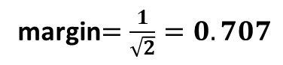
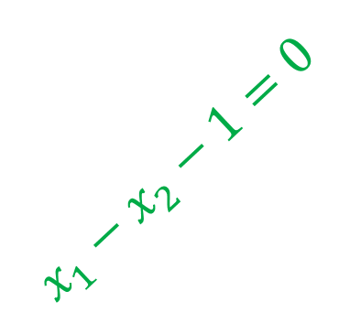
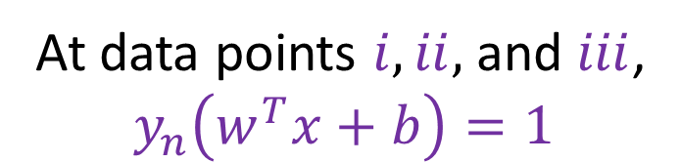
An Example
At data points $i, ii,$and $iii$,
$$y_{n}\left(w^{T}x+b\right)=1$$
margin$=\frac{1}{\sqrt{2}}=0.707$
$$X=\left[\begin{aligned}0 0 \\ 2 2 \\ 2 0 \\ 3 0\end{aligned}\right], y=\left[\begin{aligned}−1 \\ −1 \\ +1 \\ +1\end{aligned}\right]$$
$$minimize_{b,w} w^{T}w$$
$$subject to: y_{n}\left(w^{T}x_{n}+b\right)≥1$$
Solution: $w_{1}=1, w_{2}=−1,b=−1$
support vectors
$$x_{1}−x_{2}−1=0$$

Slide 54
Non-Separable Data
Two Strategies we’ve used before:
Tolerate errors
Nonlinear transforms

Slide 55
KNN

Slide 56
The $k$ Nearest Neighbors Algorithm ($k$NN)
Given a test data point $x$,
Classify it using $k$ of its nearest neighbors (in the training set)
The Nearest Neighbor Algorithm
1. Order data points according to distance from test $x$:
$x_{\left[1\right]}, x_{\left[2\right]}, …, x_{\left[N\right]}$
where $d\left(x_{\left[1\right]},x\right)≤d\left(x_{\left[2\right]},x\right)≤…≤d(x_{\left[N\right]},x)$
2. Output: $g\left(x\right)=sign(y_{\left[1\right]})$

Slide 57
What is $g$? A geometric Interpretation
The data set classifies test points
$g$ is the Voronoi / Dirichlet tessellation of $𝒳$ by $𝒟$

Slide 58
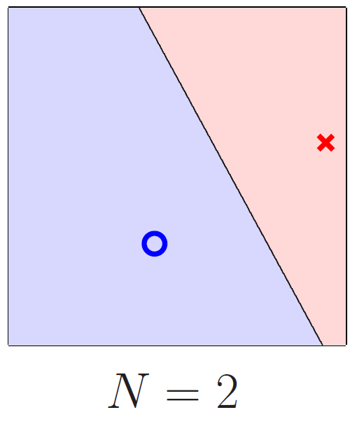
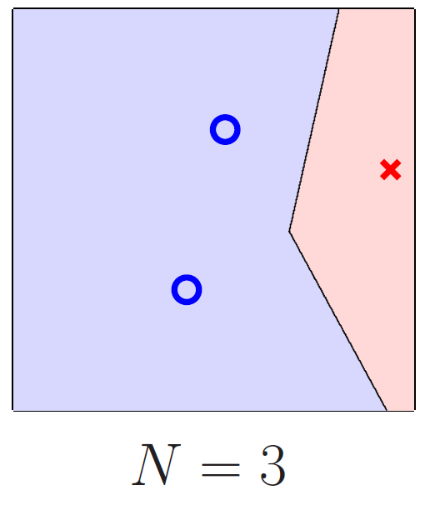
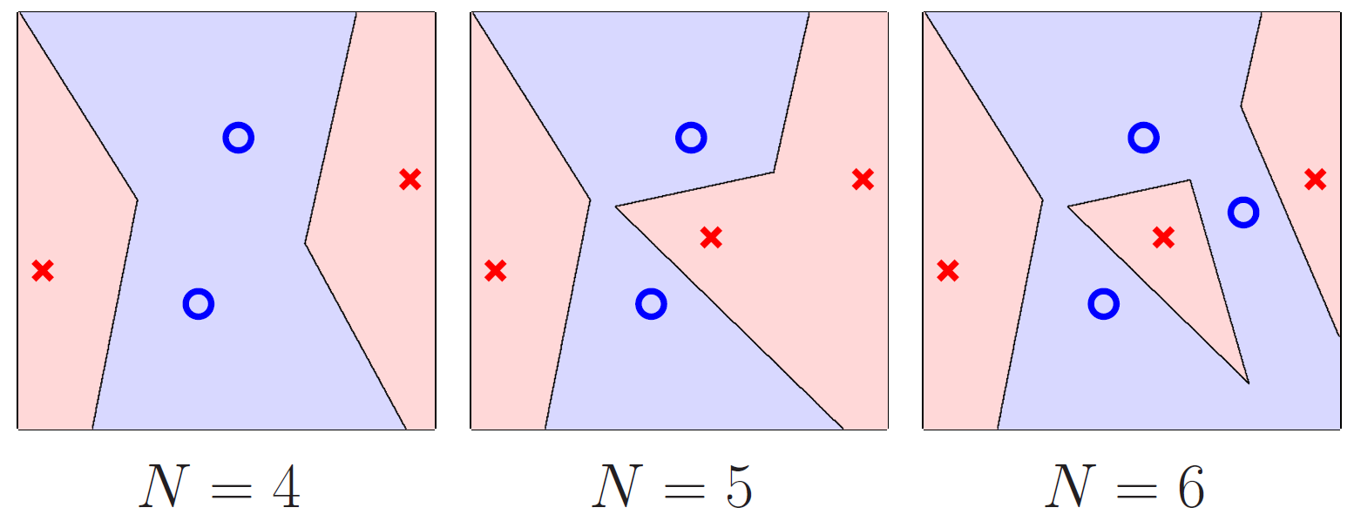
Does it Overfit?
No link from $E_{in}$ to $E_{out}$
The Nearest Neighbor algorithm is ‘self-regularizing’
The classifier only becomes more complex with more data points

Slide 59
The $k$ Nearest Neighbor Algorithm
$$g\left(x\right)=sign\left(\sum_{i=1}^{k}{y_{\left[i\right]}\left(x\right)}\right)$$
$k$ is odd, $y_{n}=±1$

Slide 60
Nearest Neighbor is Non-Parametric
NN
Linear
No Parameters
Expressive, flexible
$g(x)$ defined by the data
generic, can model any target
$d+1$ parameters
Rigid, always linear
$g(x)$ defined by weights
specialized

Slide 61
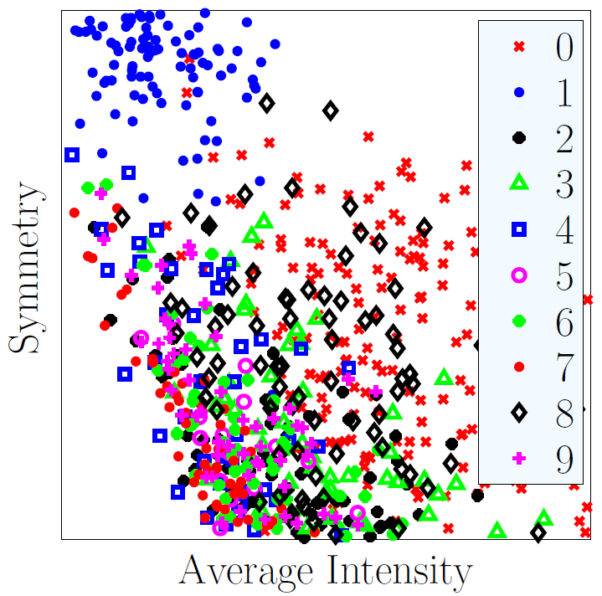
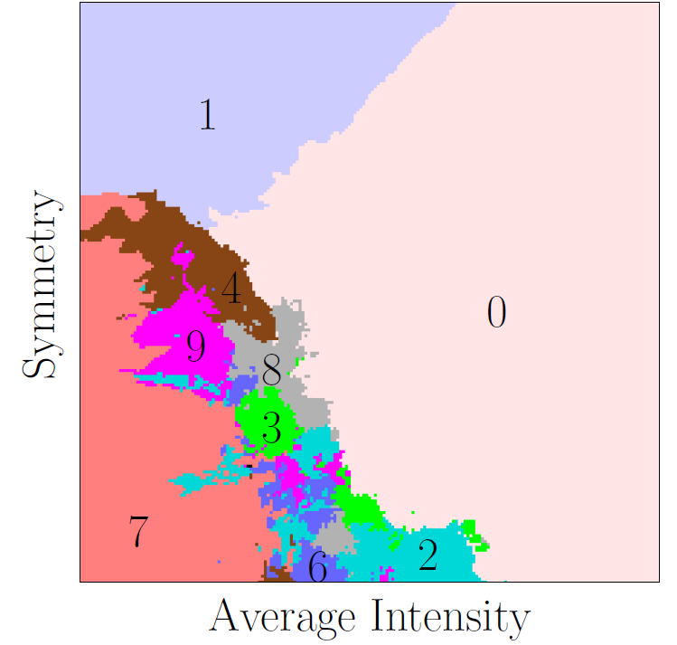
Nearest Neighbor Extends to Multiclass

Slide 62
$k$ Nearest Neighbors
Simple
No training
Near optimal out-of-sample error
Easy to justify / communicate
Easily adapted to multiclass classification
Can easily adapt to regression or logistic regression
Computationally demanding
$$g\left(x\right)=\frac{1}{k}\sum_{i=1}^{k}{y_{\left[i\right]}(x)}$$
$$g\left(x\right)=\frac{1}{k}\sum_{i=1}^{k}{⟦y_{\left[i\right]}\left(x\right)=+1⟧}$$

Slide 63
Nearest Neighbor is Computationally Demanding
Memory
Need to store all of the dataset
Computation: Finding the $(k)$ Nearest Neighbors for a test point
Need to compute distance to every point in $𝒟$
for every test point $O(Nd)$

Slide 64
Condensed Nearest Neighbor
Throw out as much data as possible
so that
all training points are correctly classified
Find a subset $S$ of the dataset $D$
Computationally hard (NP-hard)

Slide 65
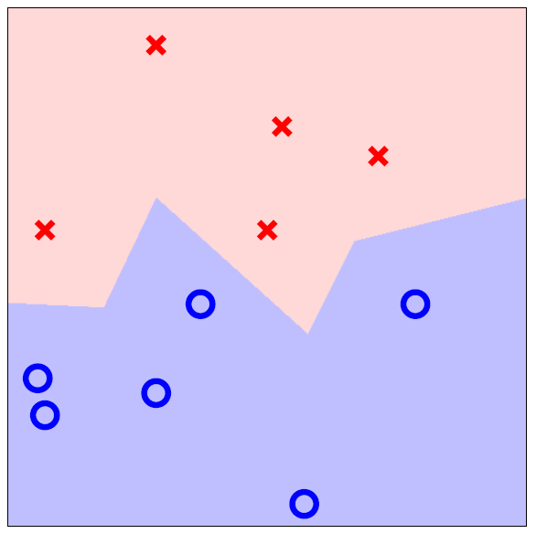
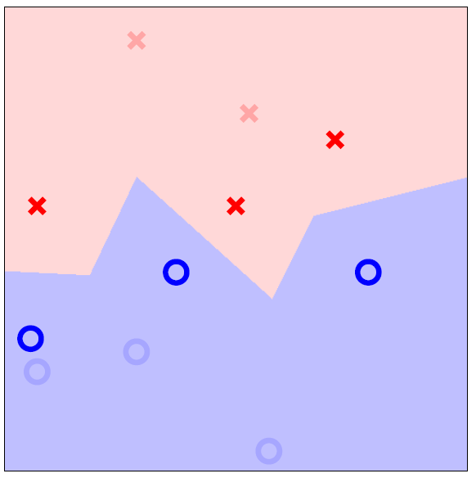
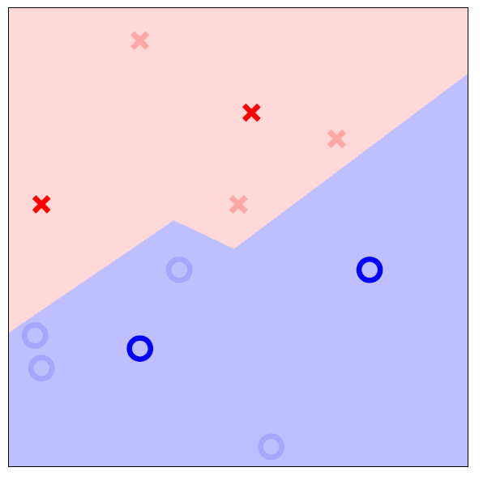
Condensed Dataset
Decision Boundary
Unchanged
$g(x)$ unchanged
$$E_{in}=0$$
$E_{out}$ unchanged
Minimal dataset
w/ $E_{in}=0$
$g(x_{n})$ unchanged
on the data
$$E_{in}=0$$
$E_{out}$ changed

Slide 66
Condensing the Dataset

Slide 67
Unsupervised Learning
Supervised learning requires a large amount of labeled data, which is expensive to obtain in many real-world applications
Unsupervised learning (with semi-supervised learning as the middle/special case), on the other hand, does not suffer from this
While supervised learning has seen several developments reaching human like performance, unsupervised learning techniques do not currently match human ability to find patterns in data

Slide 68
Identifying $k$ representative centers: Unsupervised $k$-Means Clustering
Partition input $X=(x_{1},x_{2},…,x_{N})$
into $k$ sets $S_{1},S_{2},…,S_{k}$ - clusters
with centers $μ_{1},μ_{2},…,μ_{k}$ - cluster centers
where $μ_{j}$ “represents” every data point in cluster $S_{j}$
and $E_{j}={\sum_{x_{n}∈S_{j}}{\left\|x_{n}−μ_{j}\right\|}}^{2}$ represents the “quality” of the cluster $S_{j}$

Slide 69
Finding Clusters – Lloyd’s Algorithm
Pick well separated cluster centers

Slide 70
Finding Clusters – Lloyd’s Algorithm
Pick well separated cluster centers
Compute Voronoi regions
as Clusters

Slide 71
Finding Clusters – Lloyd’s Algorithm
Pick well separated cluster centers
Compute Voronoi regions
as Clusters
Update cluster centers

Slide 72
Finding Clusters – Lloyd’s Algorithm
Pick well separated cluster centers
Compute Voronoi regions
as Clusters
Update cluster centers
Compute centers and radii

Slide 73
On the Digits Data

Slide 74
Lloyd’s Algorithm
Initialize $μ_{j}$ using the greedy approach
Construct $S_{j}$ to be all points closest to $μ_{j}$
$S_{j}←\left\{x_{n}:\left\|x_{n}−μ_{j}\right\|≤ \left\|x_{n}−μ_{l}\right\| for all l=1,…,k\right\}$
Update each $μ_{j}$ to equal the centroid of $S_{j}$
$μ_{j}=\frac{1}{\left|S_{j}\right|}\sum_{x_{n}∈S_{j}}{x_{n}}$
Repeat steps 2 and 3 until $E_{in}$ stops decreasing
Locally optimal

